Slide 1
C# Design Patterns

Slide 2
What is Design Pattern ?
How Many Design patterns are there ?
Which design pattern I have to use in my project ?
C# Design Patterns

Slide 3
There are 3 types of design patterns
GOF Design patterns

Slide 4
Creational Design Patterns
These patterns deal with the process of objects creation in such a way that they can be decoupled from their implementing system.
This provides more flexibility in deciding which objects need to be created for a given use case/ scenario.
Structural Design Patterns
These patterns deal with the composition of objects structures.
The concept of inheritance is used to compose interfaces and define various ways to compose objects for obtaining new functionalities.

Slide 5
Behavioral Design Patterns
These patterns deal with the process of communication, managing relationships, and responsibilities between objects.
Creational
Structural
Behavioral
Factory
Abs Factory
Builder
Prototype
Singleton
Adaptor
Bridge
Composite
Decorator
Façade
Flyweight
Proxy
Chain of Resp..
Command
Iterator
Interpreter
Mediator
Observer
Momento
State
Visitor
Strategy

Slide 6
Behavioral Design Patterns
These patterns deal with the process of communication, managing relationships, and responsibilities between objects.
Creational
Structural
Behavioral
Factory
Abs Factory
Builder
Prototype
Singleton
Adaptor
Bridge
Composite
Decorator
Façade
Flyweight
Proxy
Chain of Resp..
Command
Iterator
Interpreter
Mediator
Observer
Momento
State
Visitor
Strategy

Slide 7
S.O.L.I.D Principles

Slide 8
S.O.L.I.D Principles
SOLID are five basic principles which helps to create good software architecture.
SOLID is an acronym where:-
S stands for SRP (Single responsibility principle)
O stands for OCP (Open closed principle)
L stands for LSP (Liskov substitution principle)
I stands for ISP ( Interface segregation principle)
D stands for DIP ( Dependency inversion principle)

Slide 9
S.O.L.I.D Principles
S stands for SRP (Single responsibility principle)
-Concerned about single focused purpose
O stands for OCP (Open closed principle)
-Open for extension but Closed for modification
L stands for LSP (Liskov substitution principle)
-the parent cannot replace the child object seamlessly
I stands for ISP ( Interface segregation principle)
-any Interface should not force any method to class which is implementing it
D stands for DIP ( Dependency inversion principle)
-Objects should be loosely coupled and injection should happen at runtime

Slide 10
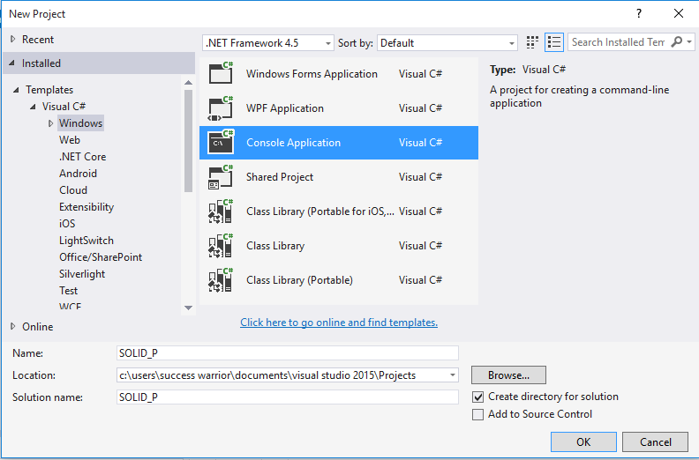

Slide 11
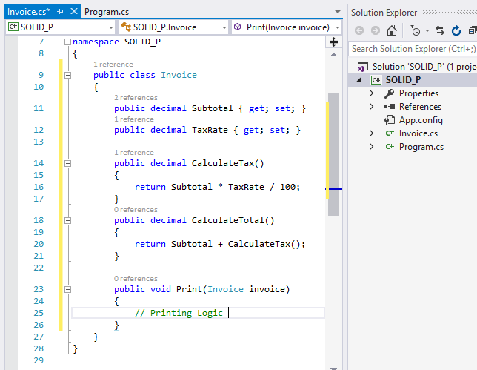
How many responsibilities
are there in this class?

Slide 12
How many responsibilities are there in this class?
Which is better option?
Class with one responsibility
Class with many responsibility

Slide 13

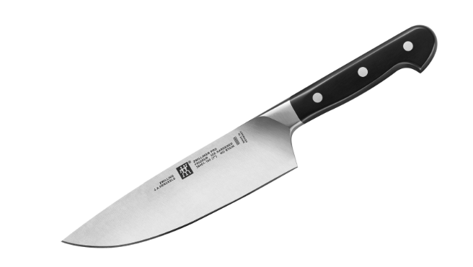

Slide 14
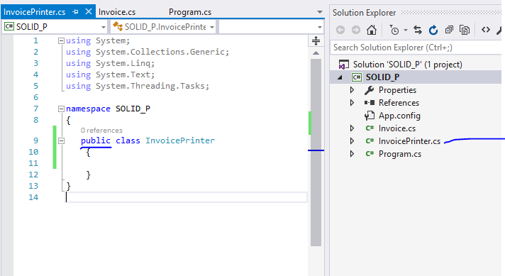

Slide 15
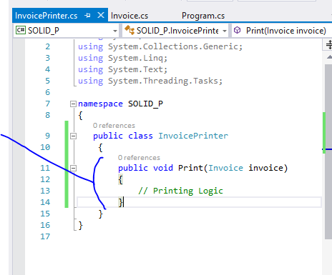
Cut and
paste

Slide 16
So now we have two different classes which only concern about their own area of expertise or domain logic
This one is going to help in TDD
S stands for SRP (Single responsibility principle)
-Concerned about single focused purpose

Slide 17
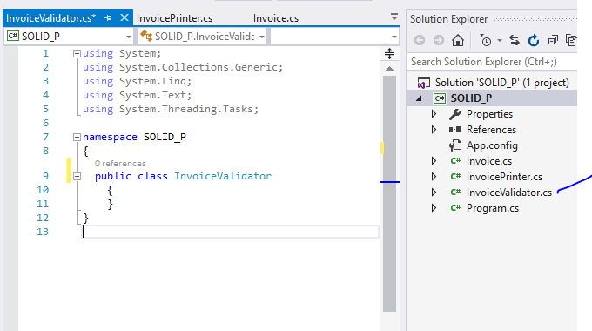

Slide 18
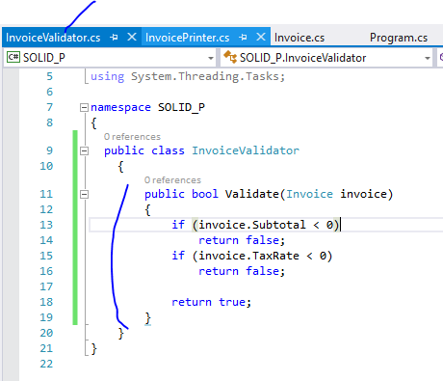
By following single responsibility principal now this class is focused on validations only

Slide 19
GUESS: What is a problem with this code?

Slide 20
We have multiple if statements and if I want to introduce new validation statement then I need to modify this class code.
O stands for OCP (Open closed principle)
-Open for extension but Closed for modification
Which means : This code should not be modified even is we add new enhancement in future and here is the place where abstract class is going to help us

Slide 21
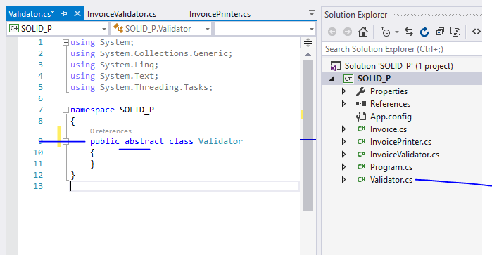

Slide 22
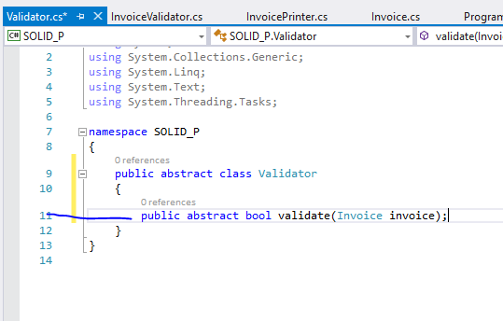

Slide 23
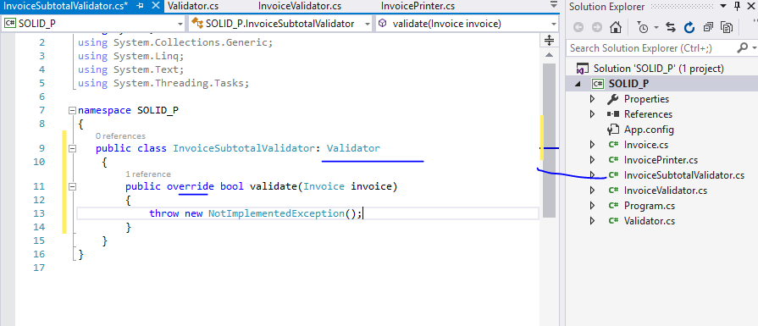

Slide 24
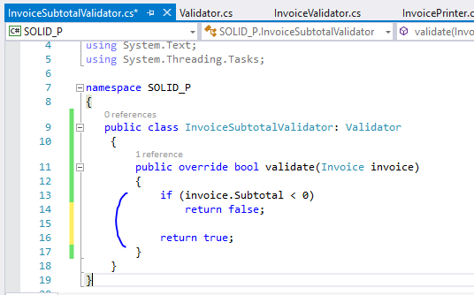

Slide 25
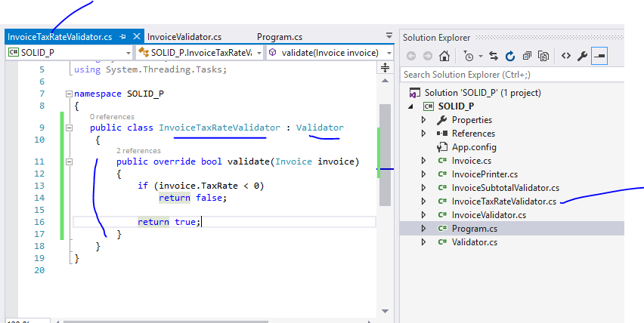

Slide 26
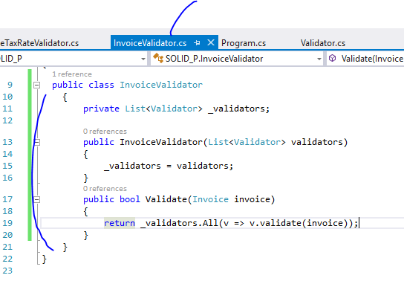
Modify code of invoicevalidator so that it will check each of these validations

Slide 27
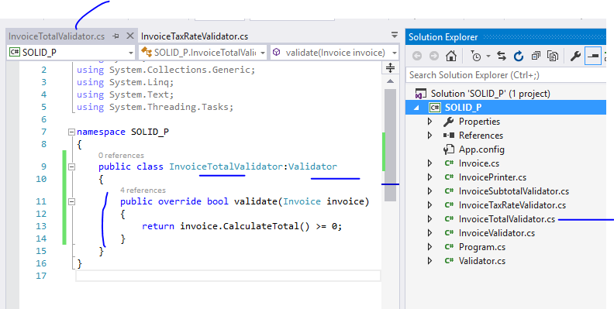
Even if I extend my validations and add new validator
I don’t need to change my InvoiceValidator class logic

Slide 28
That’s What
O stands for OCP (Open closed principle)
-Open for extension but Closed for modification

Slide 29
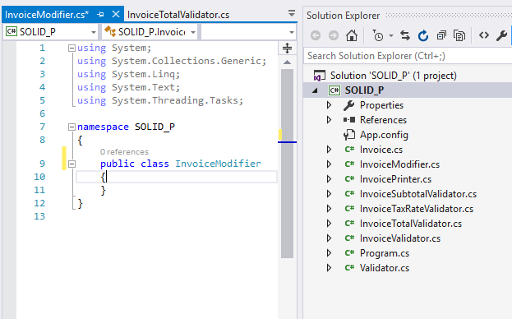
Now I am adding a new class InvoiceModifier

Slide 30
The goal is suppose we need to modify invoice by some business related request
And we don’t want to add this logic in Invoice class that’s why we created this InvoiceModifier Class

Slide 31
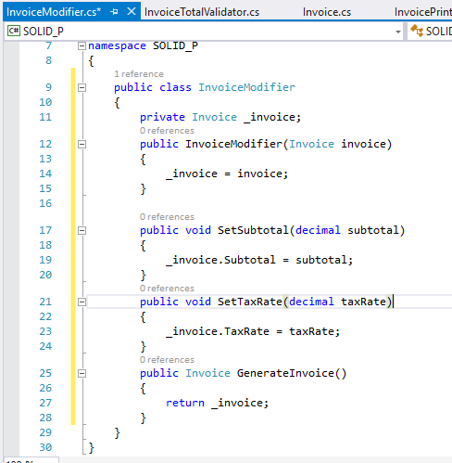
Code goes like this

Slide 32
Now suppose we got some new Complex Taxes
From government and we need to generate
One new ComplexInvoice sometimes and
sometimes Normal invoice

Slide 33
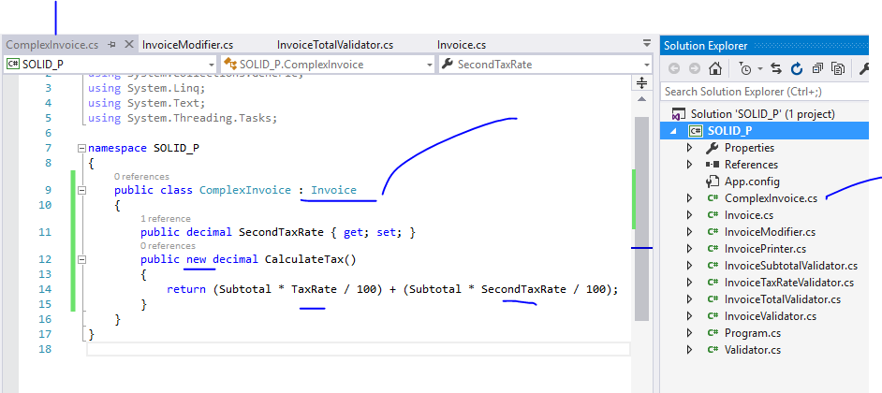
We inherited invoice and created new implementation of calculateTax method which will override based implementation

Slide 34
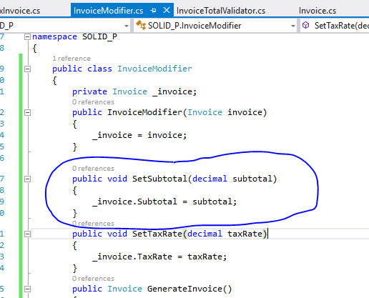
This inheritance and implementation will work fine but this will fail at this point
Because Invociemodifier
Doesn’t really know about complexInvoice Class as it is connected with Invoice only.

Slide 35
L stands for LSP (Liskov substitution principle)
-the parent cannot replace the child object seamlessly
And This is where liskov principle fail

Slide 36
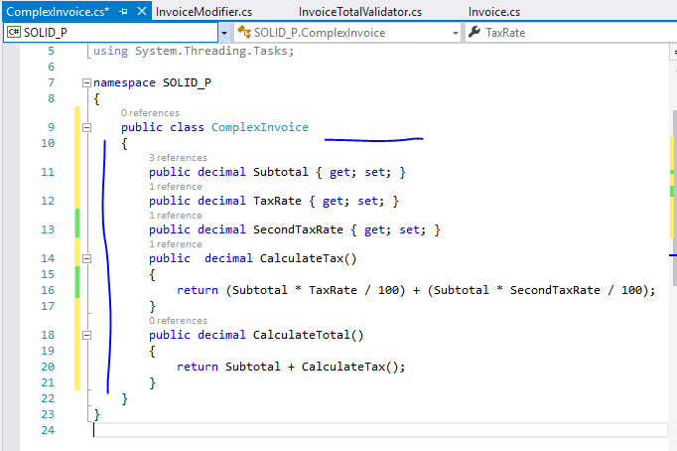
To fix this we are going to modify ComplexInvoice class

Slide 37
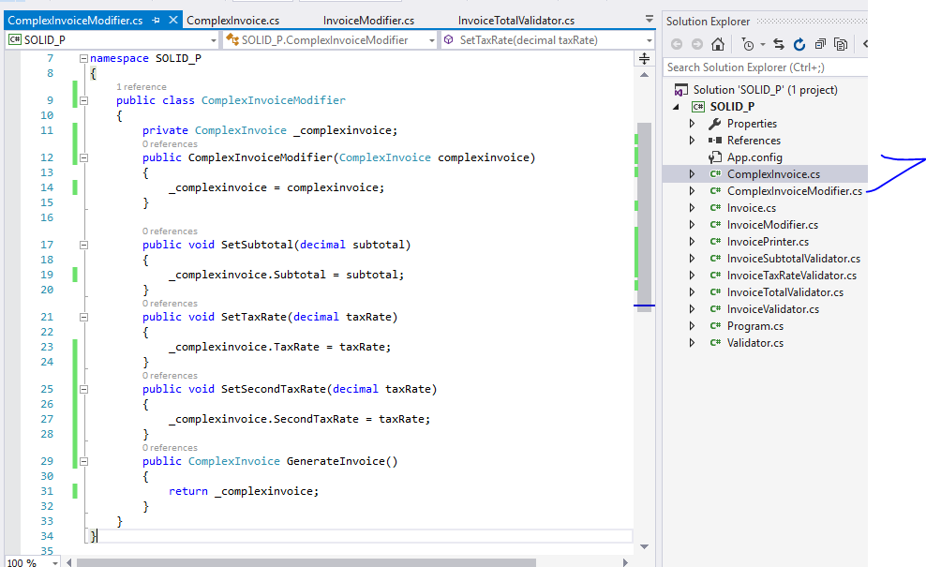
And we are adding new class

Slide 38
So we have completely separated those things out
And that’s why we don’t need to worry about implementation of invoice or ComplexInvoice

Slide 39
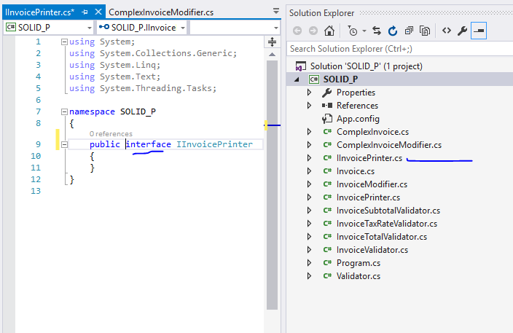
I stands for ISP ( Interface segregation principle)
-any Interface should not force any method to class which is implementing it

Slide 40
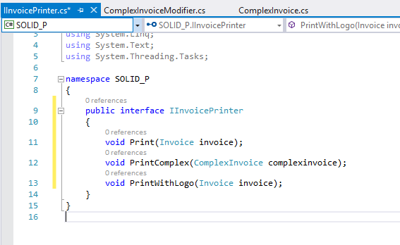
Let’s say we have three different kind of print to take

Slide 41
Now let’s modify code of Invoiceprinter class
Using this interface

Slide 42
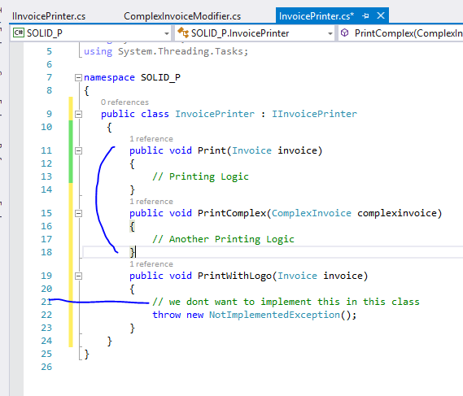
Because we are implementing interface we are forced to get this method which we really don’t care about

Slide 43
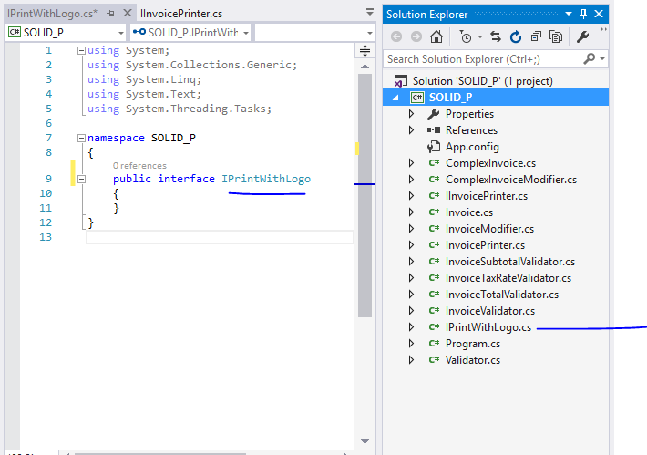
So to fix this create new interface

Slide 44
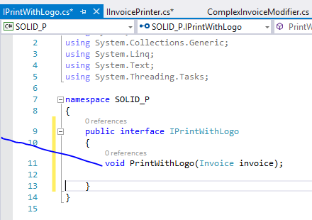
Cut and
paste

Slide 45
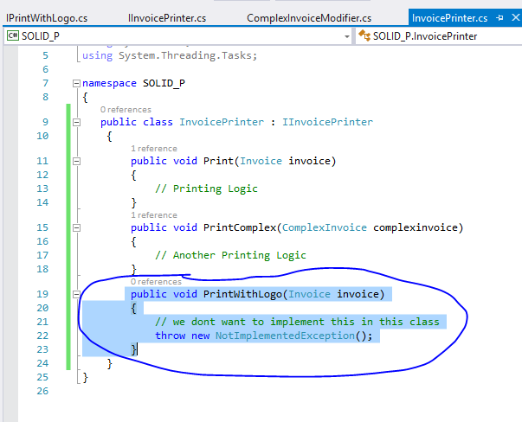
remove

Slide 46
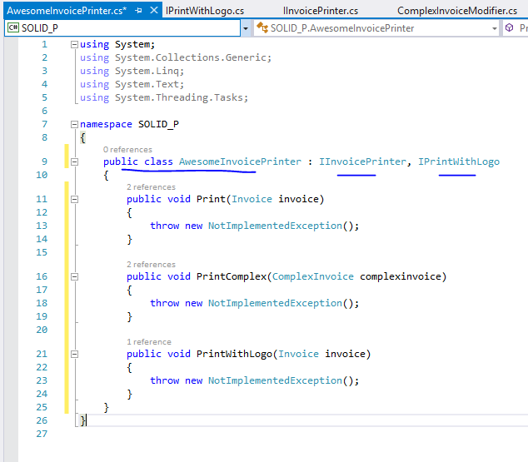
When we need both we can implement both interface in one class

Slide 47
D stands for DIP ( Dependency inversion principle)
-Objects should be loosely coupled and injection should happen at runtime

Slide 48
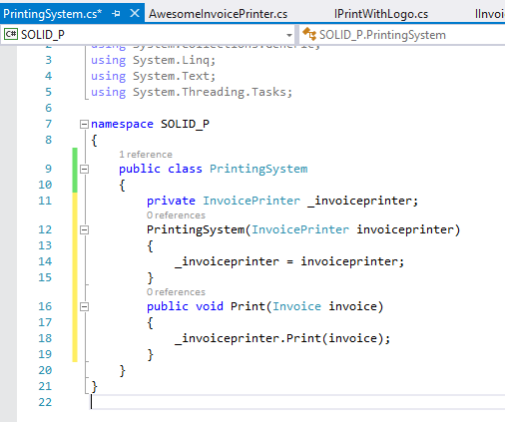
Printingsystem printing invoice using InvoicePrinter class

Slide 49
Problem will start when we will have another implementation of the printer like
InvoicePrinter in HTML or
InvoicePrinter in pdf etc
That’s why in spite of concrete implementation of the InvoicePrinter class we have to use interface to make it loosely coupled

Slide 50
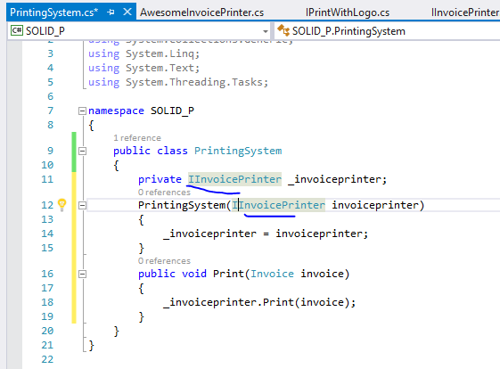
By doing this
We actually improved
Flexibility

Slide 51
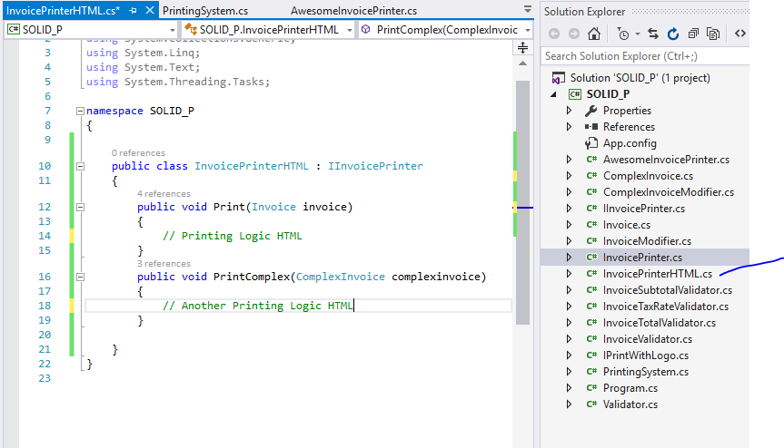
Another implementation

Slide 52
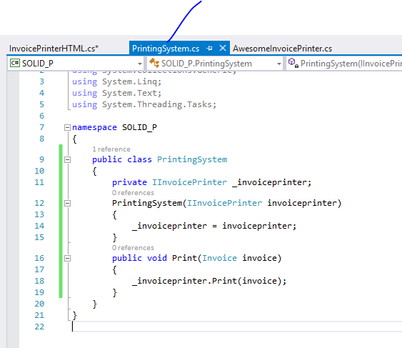
This will work fine for both implementation

Slide 53
S.O.L.I.D Principles
S stands for SRP (Single responsibility principle)
-Concerned about single focused purpose
O stands for OCP (Open closed principle)
-Open for extension but Closed for modification
L stands for LSP (Liskov substitution principle)
-the parent cannot replace the child object seamlessly
I stands for ISP ( Interface segregation principle)
-any Interface should not force any method to class which is implementing it
D stands for DIP ( Dependency inversion principle)
-Objects should be loosely coupled and injection should happen at runtime

